Slide 1


Slide 2
Strategic Plan Implementation: Activity 21
Strategic Goal: Foster an Inter-connected and equitable SDSU experience through implementing resource generation and allocation, communication and information-sharing, and systems of transportation.
By June 2021: Develop and implement a Culture of Communication Plan for the University that improves synergy and collaboration between all campus-wide communication personnel.

Slide 3
Identified Steps to Complete Activity
Bring discussion of Culture of Communication Plan to Campus Communicators Roundtable (CCR) meeting.
From the CCR meeting discussion, develop a three questions survey to send to a larger group of campus partners (to be identified by committee) for further consideration in communication planning by committee.
Develop a report/survey of comparable public universities/colleges communications teams and how they are structured.
Invite appropriate communication faculty member(s) to address committee during scheduled bi-weekly meeting on different organizational communication structures and procedures. This would also include a informal presentation/conversation on organization structures outside the university setting and best practices.
Step 6: Review survey and report results and perform a holistic analysis with the full committee. The committee will then develop a detailed list of recommendations from those results.

Slide 4
TBD
  TBD

Slide 5
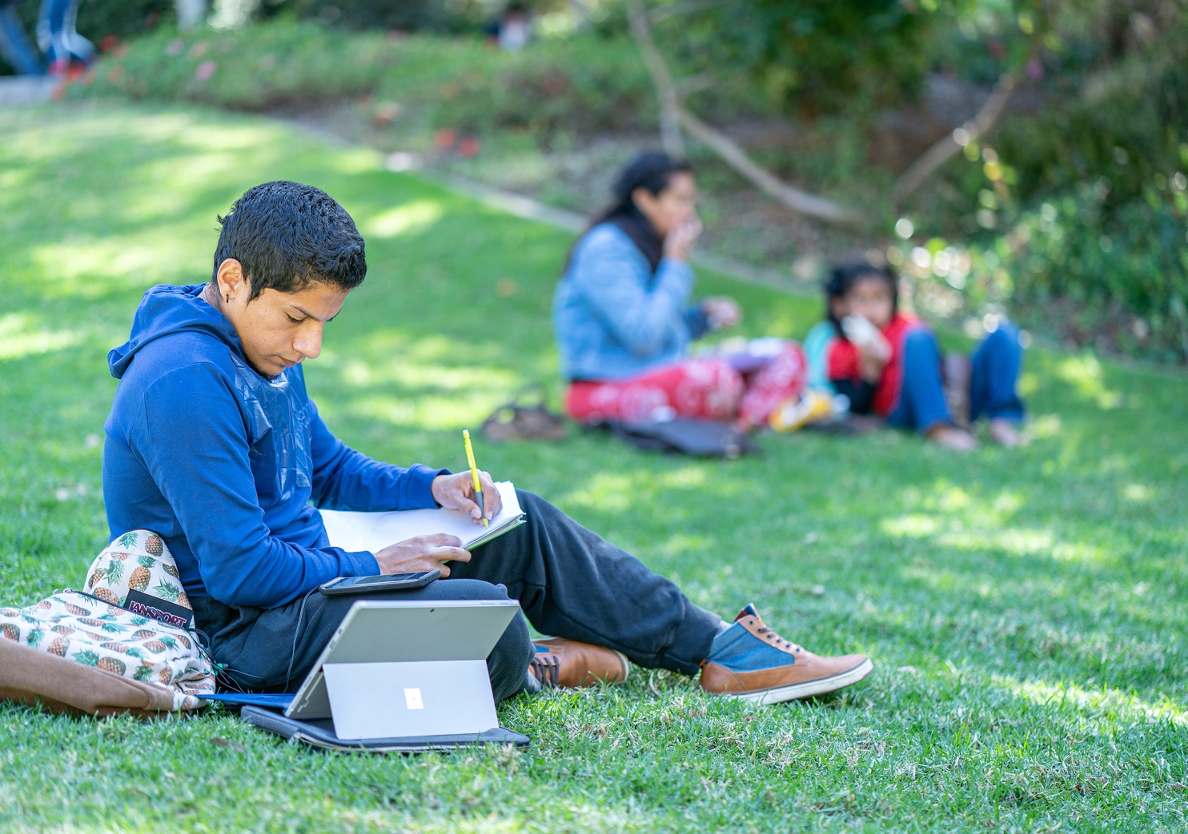
TBD
TBD

Slide 6
TBD
TBD

Slide 7
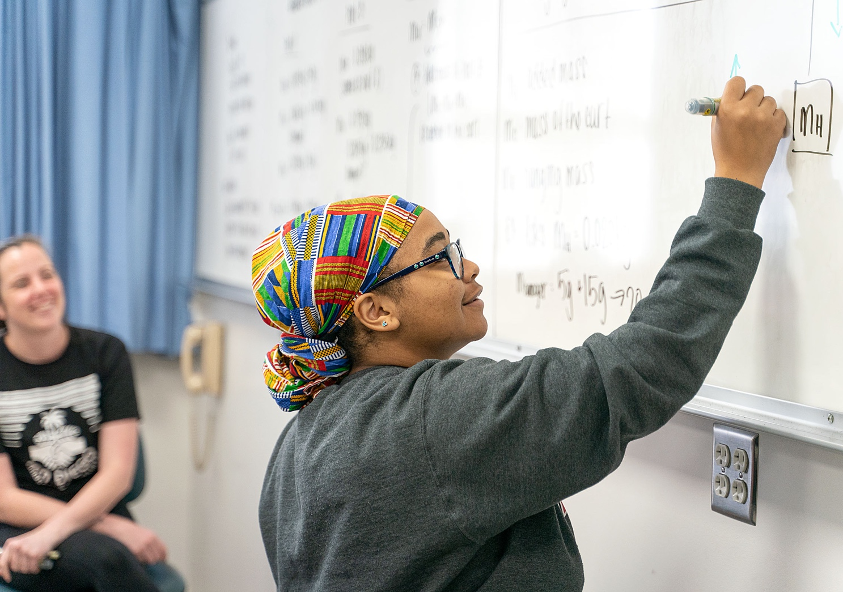
TBD
TBD

Slide 8


